Slide 1


Slide 2

Executive Summary: The analysis of the pandemics impact to finance. Utilizing a faux portfolio comprised of leading stocks of each economic sector (Pharmaceutical, Real Estate, Tech, Crypto, Retail, and Natural Resources (Gold/Oil)

Slide 3
Concept
Description:
An analysis of stock performance during the pandemic, examining the period prior to, during, and post pandemic
User story: Through the review of our data and analysis, a prospective portfolio manager can now have targeted historical price data to make informed decisions should we face another global pandemic.

Slide 4
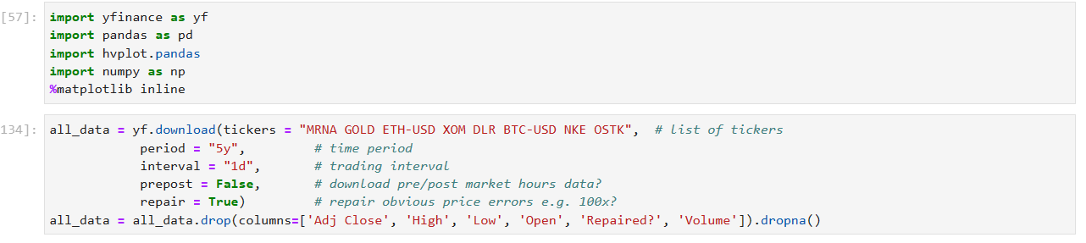
Data Techniques
Data Source: YFinance Library for Python.
Reasoning For Utilizing Data Source: Yahoo Finance was robust providing an exellent range of data on stocks bonds, currencies and crypto currency, and was beginner friendly.
Collection | Exploration | Cleaning:

Slide 5
Approach
Technologies Used: Python/Pandas, Yfinance Library,
Breakdown Of Tasks And Roles:
Rachel: proposal, research question 1.
Julian: data cleaning, retrieval, research question 2.
Monica: created repo, yfinance library, research question 3.
**team worked together in addition to individual tasks
Challenges: GitHub Branches, Understanding Yfinance library parameters
Successes: Working together, utlizing resources available to us, and using a new library.

Slide 6
Next Julian Will Demo How to Retrieve Data Utlizing Yfinance Library

Slide 7
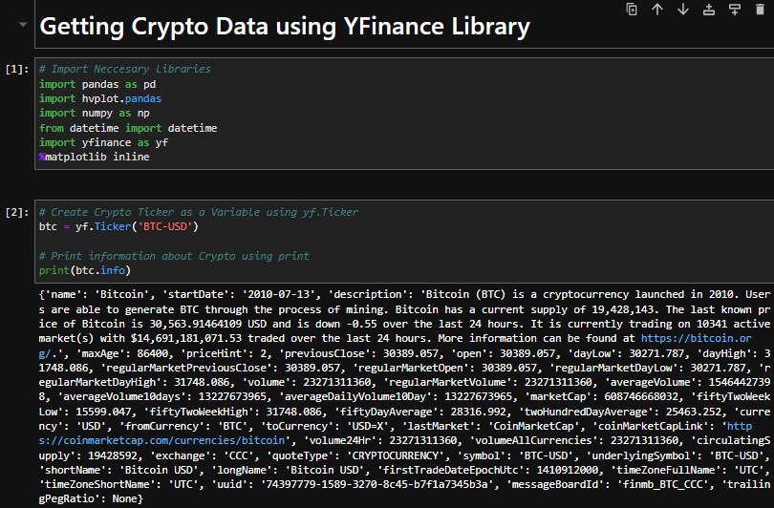
YFINANCE DEMO

Slide 8
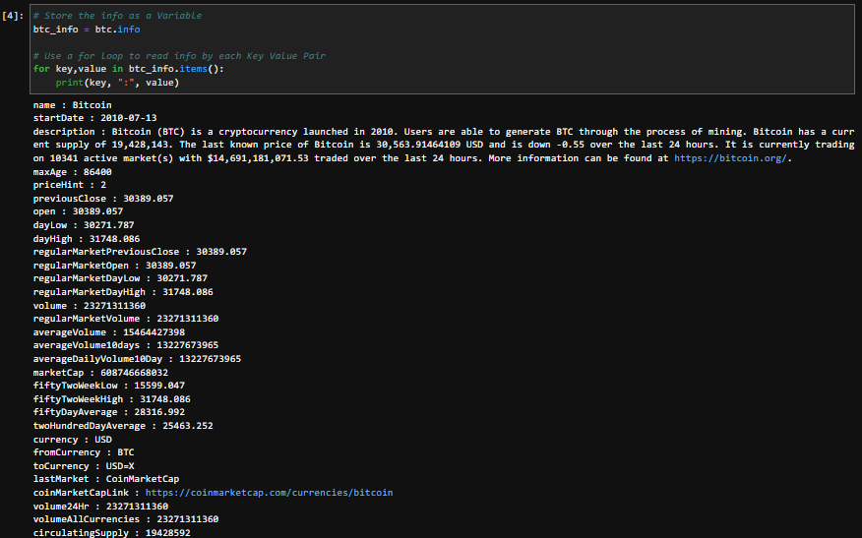
Make Info Readable

Slide 9
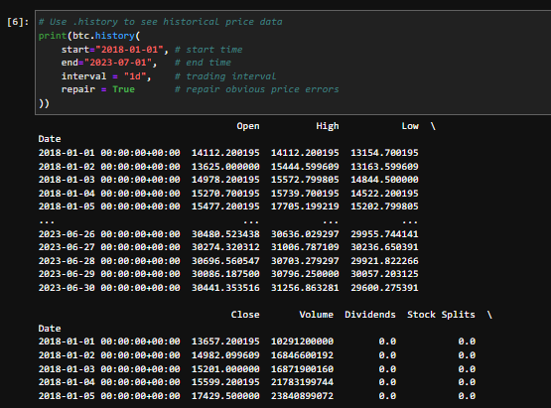
Getting Historical Price Data

Slide 10
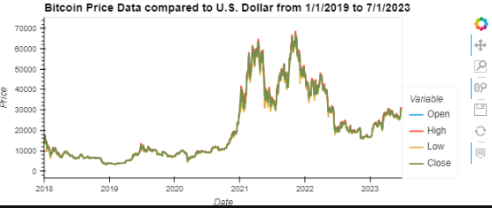
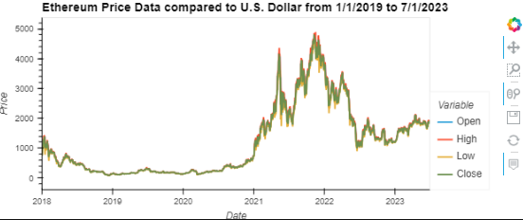
Bitcoin and Ethereum Prices Compared to U.S. Dollar

Slide 11
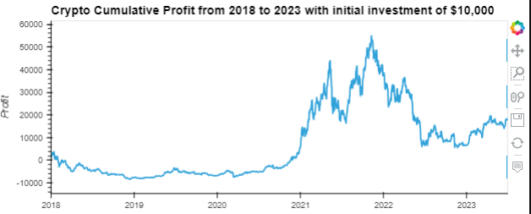
Demo

Slide 12
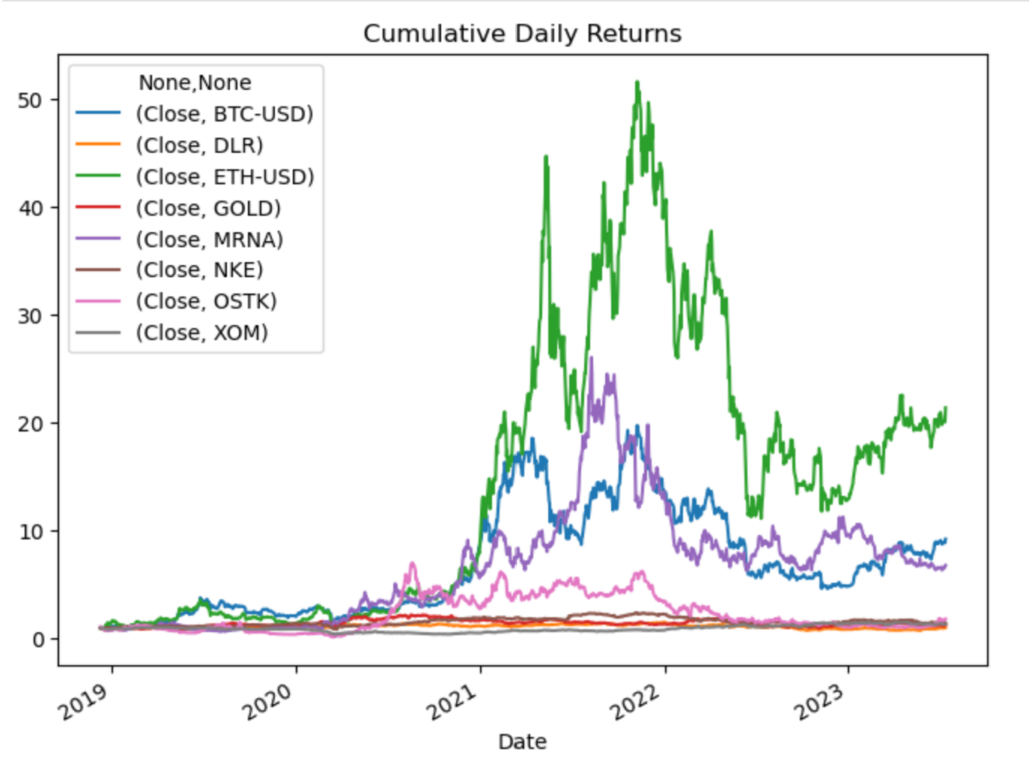
Cumulative Daily Returns

Slide 13
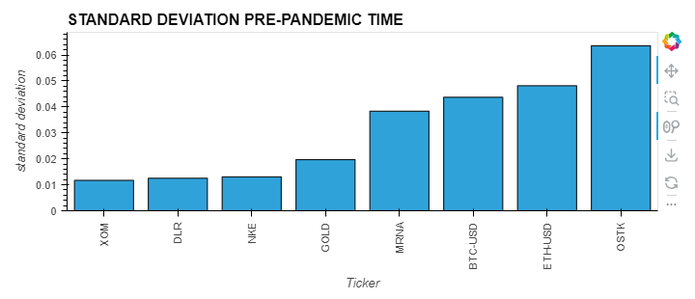
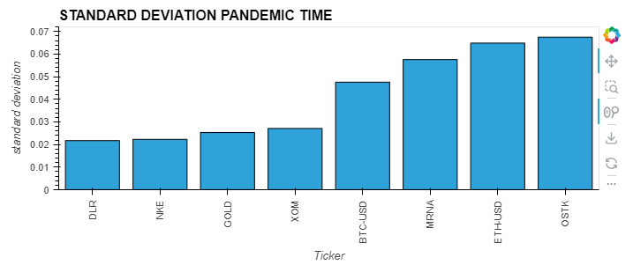
Individual Stock Risk Pre-Pandemic vs Pandemic Time
Overstock, BTC, ETH present as the most erratic stock
All stocks saw an increase in deviation but mostly behaved the same in terms of risk with comparison to each other
Overstock, BTC, ETH present as the most erratic stock before the pandemic
Oil (XOM), Housing (DLR), and Gold most stable

Slide 14
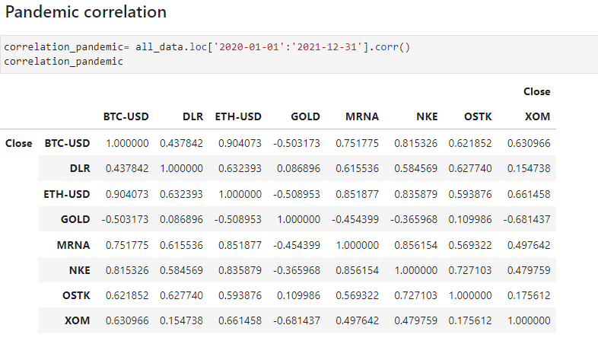
Correlation:

Slide 15
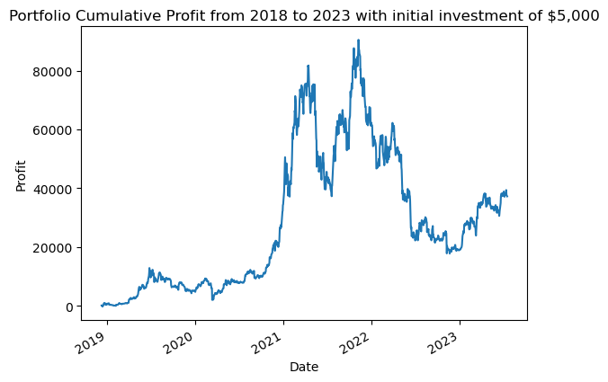
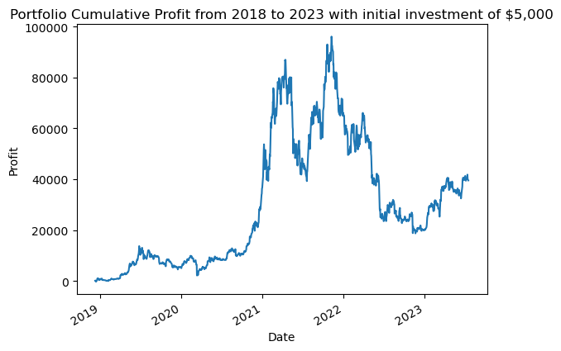
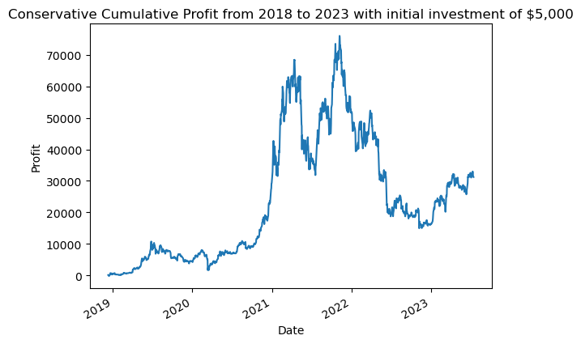
Q: What does a mutual fund compromising of key economic sectors tell us? * How did they perform individually and together as a mutual fund Demonstrated to the right is our portfolio performance for three categories: moderate risk, high risk tolerance, and low risk tolerance, respectively.

Slide 16
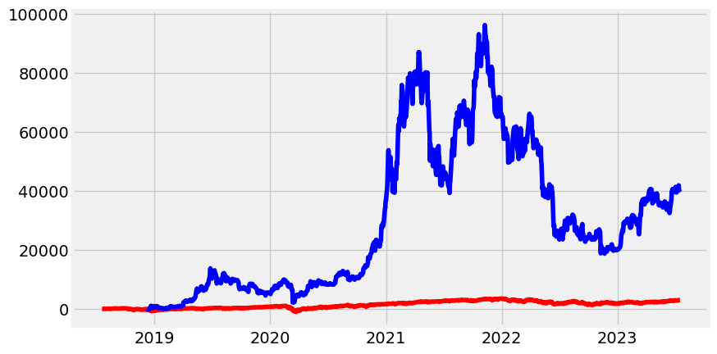
Were able to see that even with different weights (to demonstrate risk tolerance), our portfolio appears to still do well. However, that is in a vacuum; How does it perform in comparison to a major portfolio. Here is the SP500’s portfolio (red) against RJM portfolio (blue). Being able to review the Datasets and performance, if there were to be another global pandemic, how would you manage your portfolio? Would you make any changes?

Slide 17
Next Steps
Additional questions that arose: If you had an opportunity to re diversify your portfolio using this as a model how would you do it in preparation for the next pandemic should we have another.
Additional topics to research: How to prepare for doomsday/pandemic investment strategy
Plan for future development: Doomsday Trade Alert App or AI Reccession Trading Template;

Slide 18

Links and Resources
GitHub repo:
Yfinance: https://pypi.org/project/yfinance/
Yahoo Finance: https://finance.yahoo.com/

